Slide 1

Decolonising the social work curriculum
Dr Kish Bhatti-Sinclair
Reader in Social Work and Social Policy

Slide 2

Aims
Defining key terms
Introducing black perspectives
Considering the challenges of developing the social work curriculum to eradicate colonial influences
Sharing key messages to practitioners and students
Exploring organisational issues

Slide 3

Defining key terms
Colonisation
Invading and governing another country. Holding significant power and privileges over the inhabitants of that country.
De-colonisation
Withdrawal of the colonising power from a territory in order that the country can act independently.
De-colonising the social work curriculum
A social work curriculum which is independent of colonial influences.

Slide 4
Global perspectives on colonisation
Global
Commonwealth
African
Indigenous
Native American
African American
Arabian
The countries of the UK
Ireland
Wales
Scotland
Colonisation is based on exchange, trade, sexual relationships, inter-marriage, power and privilege. Divide and rule and strategic alliances are critical to success.
Therefore, the
colonised and coloniser have shared histories
colonised can also be the colonisers
colonised can contribute to colonisation
Colonising discourses are rooted in the distortion of the reality of the experience of the colonised.
This is reinforced by knowledge, power and privilege.

Slide 5
Black Perspectives
Social work education has a long history of examining the contents of curricula. Naik suggested in 1991 (p 157) that three approaches are used:
Technicist – suggests that equality is added on rather than integral.
Moral positioning – rooted in ethnic sensitivity rather than real change.
Socio-political – promotes identity, needs and aspirations.
Black Perspectives is much more than a string of words.
The circumstances that shape Black Perspectives stem from the experience of racism and powerlessness both past and present.
Black Perspectives are rooted in the principle of racial equality and social justice.

Slide 6
The social work curriculum
Qualifying standards
Apprenticeship standards
Academic standards
BASW Code of Ethics
BASW Professional Capabilities Framework
BASW Capabilities Statements
Practice Educator Standards
Knowledge and Skills Statements
Assessed year in employment standards
SW England registration standards
Undergraduate degrees
Postgraduate degrees
PhD programmes
Practice Educator modules
Professional development training
On-the job training
Supervision
Reflective practice

Slide 7
What are the concerns?
Professional fear of being called a racist
Concern to avoid sensitive issues
Difference is perceived as a problem
Anti-racist practice is an add-on and needs additional resources
Threat of new knowledge
Practice wisdom and organisational culture
Social workers support the poorest and most deprived but race, poverty and class intersect.
Curricula content is only as good as the educational standards.
Standards legitimate the profession but are based on Eurocentric, majority driven ideas rooted in philanthropy and charity.
Regulators are driven by the need to protect professional:
neutrality;
legitimacy and status;
elitism;
knowledge.

Slide 8
BASW

Slide 9
Race, poverty and class
Government, (2020), ‘Regional ethnic diversity.’ https://www.ethnicity-facts-figures.service. gov.uk/uk-population-by-ethnicity/national-and-regional-populations/regional-ethnic-diversity/latest
Poor
Poorer
Poorest

Slide 10
Messages for social workers and employers
Promote openness
Listen
Make allies
Have a team honesty box
Act on complaints
Support and guide
Take direction
Reflect and learn
Challenge
Provide easy to access systems
Ask for feedback
Believe and intervene
Respond personally and formally
Give detailed information on changes
Give credit
Celebrate achievements
Take it on the chin

Slide 11
Successful organisations
See diversity as an institutional strength
Have positive approaches to accountability
Reward good practice
Refer to global indicators of success
Spot and encourage talent
Incentivise innovatory approaches to service improvement
Collect data on ethnicity, promotions and pay gaps
Examine racial disparities
Put in place positive measures themed around equalities and anti-racism
Encourage evidence and research based practice from global sources
Support external funding for specific projects

Slide 12
Messages for managers, trainers and teachers
DON’T…
Conflate the experience of racism with other discriminatory actions
Deny, downplay and dismiss
Appropriate cultural practices
Compete with black people
Act indifferently
Fear open discussion of racism and discrimination
Respond defensively
DO
Be mentored, guided and led by black staff on experiences of racism
Set people up to succeed
Lead by example
Incorporate anti-racism within aims, objectives and learning outcomes
Test and assess on attitudes and behaviours

Slide 13
Language and names
DON’T
See language as the main and only problem
Shorten or westernise names
Dismiss unusual words or terms
Assume privilege is shared
Link to group identity or kinship
Stereotype
Make judgements
Fantasise
DO
Examine the power and impact of language, accent, tone and general demeanour.
Reflect on the origin of names such as ‘Sinclair’
Ask people to share the origins of their names
Consider the underlying reasons for lumping groups together (e.g. Black, Asian Ethnic Minority – BAME)

Slide 14
The Equality Act 2010
The Equality Act brought together over 116 separate pieces of legislation into one single Act. The Act provides a legal framework to protect the rights of individuals and advance equality of opportunity for all. It provides Britain with a discrimination law which protects individuals from unfair treatment and promotes a fair and more equal society.
The nine main pieces of legislation that have merged are:
the Equal Pay Act 1970
the Sex Discrimination Act 1975
the Race Relations Act 1976
the Disability Discrimination Act 1995
the Employment Equality (Religion or Belief) Regulations 2003
the Employment Equality (Sexual Orientation) Regulations 2003
the Employment Equality (Age) Regulations 2006
the Equality Act 2006, Part 2
the Equality Act (Sexual Orientation) Regulations 2007

Slide 15
The Equality Duty
The Equality Act 2010 places a number of duties on universities and employers. This includes creating an environment in which students and staff are:
treated equitably, valued and respected; and
not discriminated against or disadvantaged because of age, disability, gender reassignment, race, religion or belief, sex or sexual orientation.
Legal protection is in place for marriage, civil partnership, pregnancy and maternity.

Slide 16
Harassment, intimidation and bullying
The Equality Act 2010 sets out the legal compliance for anti-discrimination practices.
Universities and employers must ensure that students and staff are treated with dignity and respect e.g. in practice placements.
Universities have equality statements and duties which state that they do not tolerate any harassment, intimidation or bullying, including the abuse of a position of status, power or trust, by, or to, its students, staff, contractors, visitors or partners.
The Equality Act 2010 prohibits third party harassment.

Slide 17
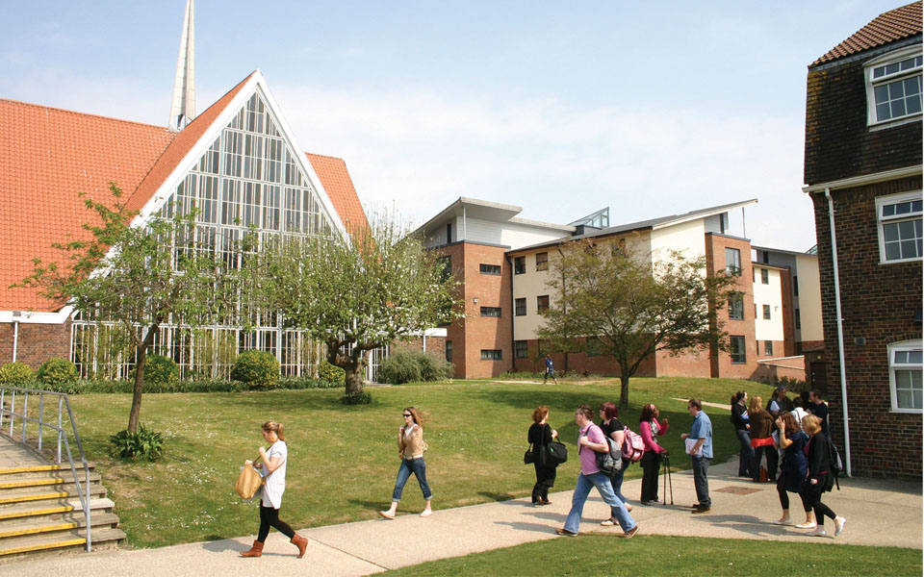

Anti-racist curriculum content
UNIVERSITY
Admissions systems
Pre-entry information
Entry and registration
Contractual arrangements
Student declarations and consent
Information and communications
Social media
Marketing and images
Inductions
PROGRAMME
Lesson plans
Teaching methods
Reading materials
On-line resources
Assessment
Marking
Examiners and markers
Assessment Panels

Slide 18
Practice Placements
Cultural norms, unintended consequences, discriminatory taken-for-granted ways of doing things, dominant cliques, indirect exclusions and unconscious bias can all sustain racism and unequal outcomes for Black people even in organisations with better intent.
Wayne Reid, BASW, April 2021
How does a student who is different fit into this?
Where are the opportunities for alternative stories and narratives?
Is there a curriculum linked to assessed practice?
Is anti-racist practice taught and assessed?
If so what does it include?
How are black and minority students empowered in a situation which is inherently disempowering?
How available are whistle blowing and complaints procedures?

Slide 19
In conclusion…
There is a great deal of work to be done! Every area of the design and delivery has to be scrutinised and changed starting with all qualifying and post-qualifying standards.
However, the Black Lives Matter movements has provided a window of opportunity to make changes.
There is more energy and enthusiasm now than for many decades so we must seize the day!
Follow:
Wayne Reid Twitter: @wayne-reid79
Social Work Anti-Racist Social Work Education Network
Twitter #SWEARN

Slide 20
Resources shared by Wayne Reid, BASW
https://www.basw.co.uk/media/news/2020/oct/basw-englands-response-minister-equalities-report-disparate-impact-covid-19
https://www.communitycare.co.uk/2020/07/17/promote-anti-racist-culture-social-work/
https://www.communitycare.co.uk/2020/12/16/anti-racism-social-work-questions-just-actions-please/
https://make-it-plain.org/2021/02/12/social-work-is-institutionally-racist-heres-how-we-fix-it/
https://nowthenmagazine.com/articles/outlanders-hidden-narratives-from-social-workers-of-colour
https://www.skillsforcare.org.uk/Leadership-management/developing-leaders-and-managers/Supporting-the-diverse-workforce-within-adult-social-care.aspx#WebinarSeries

Slide 21
Thank you!
Kish Bhatti-Sinclair
Reader in Social Work and Social Policy
Head of Social Work and Social Care
University of Chichester
Email: K.Bhatti-Sinclair@chi.ac.uk

