Slide 1
Stability for Who? An exploration of the experiences of parents who have children in foster care
Seán Lynch & Majella Hynan
14/06/2019
All Ireland Social Work Research Conference

Slide 2

Background to the Study
The Family Advocacy Service, LSSC
Support with the Child in Care Plan / Child in Care Process
Liaise with and provide information on appropriate services
Meetings: preparation and accompaniment and follow up afterwards i.e. Child in Care Reviews
Offer different levels of support: one to one and group support. Varies for each service user
The Peer Support Group

Slide 3
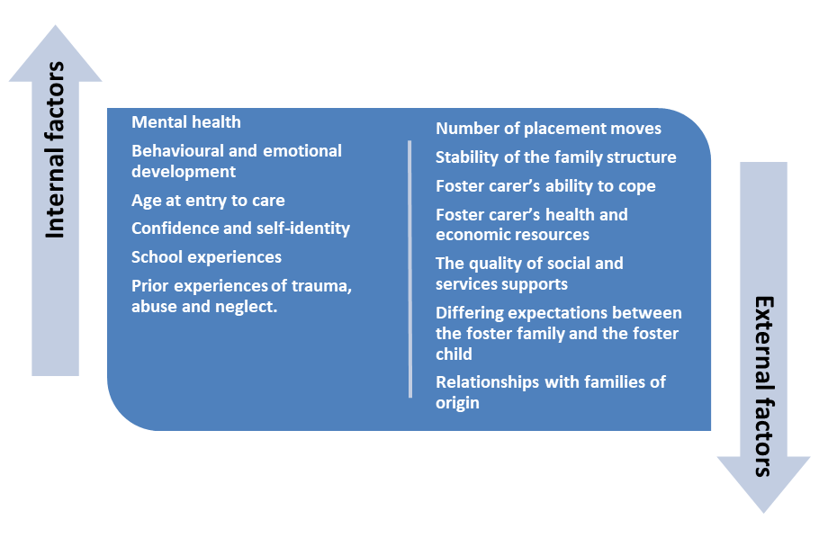
Stability in Foster Care
Stability is rooted within children’s feelings of stability, connectedness and belonging which can be characterised by emotional attachments to adults and siblings (Schofield et al., 2012).
Stability as a feeling of security: A base from which children and young people can develop social networks and supports (Moran et al, 2016)
(Moran et al., 2016; Roarty et al, 2018:53-54)

Slide 4
Introduction to the Research
‘Stability’ in care: Where is the parent in this?
This study sought to highlight the voices of parents in relation to their experiences of their relationships and engagement with foster carers and social workers.
Seven participants
Initially several more committed - complexities of people’s lives evident in the participant recruitment process.

Slide 5
In exploring factors that contribute to ‘placement stability’ research has shown the connection to the birth family as a powerful theme (Tobin, 2011).
A dearth in the literature?
Parents with children in foster care represent a group whose voices are seldom heard (Höjer, 2011).
How does systemic factors affect meaningful contact or engagement with services?
While a positive connection is noted, how is this achieved, promoted or experienced?

Slide 6
Research Design
Ethics
Theoretical Framework
Methods and Methodology

Slide 7
Preliminary Research Findings
Power/lessness
The Importance of Communication
The Value of Relationships
Systemic Factors

Slide 8
Powerlessness
Feelings of powerlessness were cited, with reference to feeling unsupported, alone, isolated and withdrawn from their communities.
Frustration and the exacerbation of underlying difficulties were evident in parent’s experiences.
Many parents are left to deal with the trauma and loss of a child on their own, particularly as they may be ostracised by family and friends due to the stigma and shame of court-ordered removal (Morris, 2018; Broadhurst and Mason, 2014).
This parent spoke of her way of dealing with stigma in her community and the hurt that she experiences because of having a child taken into care:
“Over the years, you just block it out, you just learn. It’s like you put on armour, where you can’t get hurt. It’s an invisible armour or a mask so when you meet people, you’re totally protected inside and they can’t hurt you, but you’ve got to learn how to put these on.”
A parent spoke of the impact that key dates have on her:
“Birthdays and Christmas, you get too depressed, you are just left there, rotting alone, literally alone, inside yourself, going deeper and deeper and you’re trying to find a way out and you’re screaming for help.”

Slide 9
Powerlessness
Commenting on the complexity of parental experiences, Schofield, et al. (2011: 75) assert that the emotional reactions to a child going into foster care are ‘powerful, diverse’ and that ‘often contradictory feelings arise from their experience of loss’.
How this manifests can have further consequences for parents.
Emotional over-reactions such as anger, irritability in meetings, during contact, or towards professionals can influence perceptions of parents’ stability (National Child Traumatic Stress Network, 2018).
Several parents spoke of feeling that they had to hide their true emotions as “it may be used against them”.
The feeling of having to suppress intense emotions was highlighted by several participants in the research. One parent called for a recognition of the emotions being expressed as natural:
“Well I think the social workers need to understand and fair enough not doing it in front of your child, but like it’s normal for parents to get thick, upset, angry, cross, cry. They are all natural emotions to have and if you do that in front of the social workers, they can label you unstable, and say oh your behaviour is erratic, your behaviour is a concern. They are normal emotions. You come and take someone’s child off them, am I supposed to turn around and say Jesus lads, thanks very much, you’re after doing me a favour. I’m going to go out now and enjoy myself. No, I’m going to be upset, angry, I’m going to cry, it’s my child, it’s my baby.”

Slide 10
Powerlessness
The loss of a child through the care system has an enormous psychological affects on parents and can lead to circumstances that Broadhurst and Mason (2017) describe as ‘collateral consequences’.
The stigma and strong emotions that arise from having children in care can intensify parents’ underlying difficulties and this can often lead to crisis.
Within our study, the frustration and the exacerbation of underlying difficulties were evident in parent’s experiences.
Previous research has asserted that parents felt that society labelled them unfairly as ‘unfit’ and ‘bad parents’ and they are ‘powerless in determining their own futures’ (Moran et al, 2017:56; Slettebo, 2011; Regan and Riddler, 2010; Morris, 2018).
This was also evident in our study where parents spoke of the stigma they faced in their local communities when a child, or children, were removed from their care:
“If you have permission to collect your child from the school, and everyone else is collecting theirs, it’s like they’re looking down at you. It’s like everyone’s talking about you and you can hear them all whispering. You’re standing there, going oh my God they’re all talking about me now and you can hear them, you can feel them looking at you... you can hear them nattering.”

Slide 11
Powerlessness
Power is embedded within social work practice (Smithson and Gibson, 2017)and this was frequently cited by parents.
As noted by O’Brien et al (2015:8), the ‘anger, frustration and powerlessness’ of parents engaging with the care system can militate against meaningful contact.
Several parents spoke of feeling disempowered even when they were included in events relating to their children:
“I used to go to his doctor’s appointments when he’d be getting his injections. If he was upset and all, the foster carers would take him away. They never gave me that chance to like soothe him or try and calm him. They wouldn’t even say did he want to go to me and like I’d find that hard because I'm his mother and like he was sore…..”

Slide 12
The Value of Relationships
Establishing caring and supportive relationships with the foster family is considered a crucial need of children in care (Bell et al, 2015).
The importance of forming and maintaining appropriate relationships between parents and foster carers was highlighted, as were the benefits to all involved when this worked well.
Where these relationships are in the child’s best interests, children in foster care generally need continuity of the relationships with their birth family members (Mason 2008; Moran et al, 2016).
The challenges faced by parents included feeling that decisions were made without their input or being isolated in matters relating to their children.
In discussing their relationship with their children’s foster carers, themes of being included and valued emerged in parents’ narratives, and the smallest gestures were greatly cherished:
“I know it’s not a lot to people but when you’re a parent and you get a birthday card, it’s not about the present but it means a lot. I’m never forgotten for my birthday, never forgotten for Christmas, Mother’s Day, Easter. Like I’m number one, she makes me feel number one to my children so I’ve nothing but good things to say about the foster carer.”

Slide 13
The Value of Relationships
Mutual respect (with the foster carer’s) was fundamental, as asserted by this parent:
“There’s respect there, from one mother to another mother... if you don’t have respect for each other there’s no point even in trying to make it work.”
The challenges faced by parents included feeling that decisions were made without their input.
Parents felt it was important to keep updated on all matters relating to their children such as school and activities:
“I know they have to care for the children, but it’s great when you get included... even though it doesn’t feel like you’re actually included, like going on trips with them (laughs)… It doesn’t have to be that, it’s the little things like the updates or even the small talk at meetings”

Slide 14
The Value of Relationships
Several parents reported having a positive relationship with previous social worker’s and foster carer’s, as highlighted by this parent who spoke positively of her experiences prior to reunification:
“It was all about working together, making decisions together. No decisions were made behind my back, I was involved in everything. So that’s what made it work for me when I felt that I was involved and included in every decision.”
The relationship with the allocated social worker was discussed, both in its challenges and benefits.
A core theme referenced by parents was the feeling of having to navigate supports on their own:
“The best line that I heard that’s used by social workers, is I’m not your social worker, I’m your child’s social worker. I feel that I cannot go and ask any one of them for help, and yet the child is taken from your care because you’ve done wrong. Yes, you admit you’ve done wrong, you’re screaming for help, to get better so you can actually have your child home with you. They should actually be there and saying that we’re here to support the family, but I don’t feel like they’re supporting the whole family.”.”

Slide 15
Importance of Communication
Open communication between social workers, foster carers children and families was seen as having a positive impact on relationships.
The ‘little things’
Parents highlighted the benefits of feeling listened to and being involved in matters relating to their children as well as adequate notice of meetings and contact.
When communication was positive:
“I feel like I am involved with my children so that’s what makes it work for me. I know my kids are okay, even if they’ve got the dentist, I don’t have to wait to go to a case conference to find it all out. But it hasn’t always been like that, I had to fight so hard to get myself included in my children’s lives.”

Slide 16
Importance of Communication
In a previous study, parents commented that they ‘do not receive enough information about their children from child welfare systems and foster carers and they felt it was their right to receive this information’ (Moran et al, 2017:58)
In our study parents highlighted the importance of being informed and involved regarding their children’s lives. Many parents reported that they do not receive enough information about their children and the distress that this can cause was evident:
“I find it hard when I know nothing about my children. I didn’t find out for a few weeks that my child had been in hospital...”
Parents voiced their views regarding the lack of information on their children, and also the short notice given for access cancellations.
Another parent spoke of her baby’s first Christmas and the distress that this caused her given that no services were available for contact:
“The foster carers wouldn’t and there was no social worker willing to contact me on Christmas day and let me know what my child’s first Christmas was like. That was the worst day, like, the day when he was taken off me was bad but Christmas day, my child’s first Christmas, that was the worst of all. I know he didn’t know what was going on, like, but not to even receive a call, a picture or even an email of my child on Christmas morning opening his presents that I got him, like... it was horrible.”

Slide 17
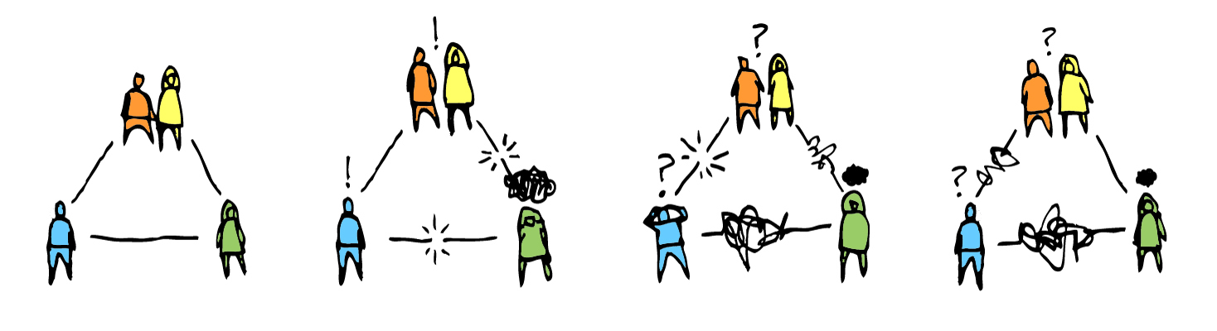
Systemic Factors
Following having a child removed from their care, ‘the sense of loneliness and isolation impacts severely on parent’s mental health, their ability to cope with everyday routines and how they manage relationships with foster carers, children, and social workers’ (Moran et al, 2017:57).
Many parents are left to deal with the trauma and loss of a child on their own (Morris, 2018).
Within this study systemic factors cited by parents were change in social workers , directives not being undertaken in a timely manner, lack of supports following reunification and the lack of targeted supports to prevent care proceedings occurring.

Slide 18
Systemic Factors
It is well known that the majority of families involved in child protection experience multiple chronic stressors including poverty, marginality, family problems, housing instability and social isolation (Kojan, 2010).
Relative deprivation involves greater social insecurity and a range of risks are associated with income poverty (Featherstone, 2016).
Stressors associated with parenting in poverty, ‘including a lack of access to appropriate support services, are likely to impact upon the quality of parenting and increase, but do not accurately predict, the probability of maltreatment’ (Hyslop et al, 2018:6).
Parents said that navigating services was a challenge and that the pace of change was frustrating.
A parent spoke of waiting for over five years for their contact to be increased, despite remaining sober:
“It’s been so hard because it’s their way or no way. I’m doing the same thing for five years. It’s been a long time. I should at least deserve to be getting her for the full day. Everything they’ve asked me, I’ve done. I’m clean and they’re telling me how good I’m doing and this and that but it’s no good telling me how good and then still give me two hours (contact) a month.”

Slide 19
Systemic Factors
Child protection is practiced in a context of uncertainty, risk and deep anxiety (O’Sullivan, 2018; Featherstone, 2016).
A difficult context to form relationships?
Foster carers’ and parents’ relationships can be strained, given the varying perceptions regarding the best interests of children and the challenges in understanding each other’s perspectives (Browne, 2002).
Several parents spoke of the difficulty in forming and maintaining relationships with social workers and the challenge that meeting a newly allocated one and ‘re-telling your story’ can have. One parent noted:
“You could have a social worker, then all of a sudden you’ll get assigned a new one and at the start, they ask questions like ‘how are you feeling’, and I’m looking at her...what do you want me to feel? How am I feeling inside? You live in my shoes and have your children taken from you and then tell me how you’re feeling inside”

Slide 20
Systemic Factors
The stigma and the disqualification from parenthood which occurs with having children removed by the care system can amplify the parents’ underlying difficulties and this can often lead to a downward spiral (Morris, 2018).
Anger, frustration and powerlessness can militate against meaningful contact (O’Brien et al, 2015:8).
A participant noted the struggle in maintaining hope for the future:
“I’ve seen this with other parents too… they end up feeling on their own with no hope. You could have a parent that might be vulnerable and could relapse and just throw everything away and say I fought for this so hard and what’s the point now, you know”.

Slide 21
Systemic Factors
Several parents reported spoke of staff turnover being a huge issue for them:
“it can really depend on like the social worker because I know that like [SW] was lovely and like she still had a job to do and we still had arguments like don’t get me wrong, but she was way nicer at doing things and she did the same job as any other social worker but she did it in such a nicer way than any other I've had”.
Another parent noted:
“I know [SW] was working for the child but she took the time to actually tell me what needed to be done and supported me in getting into services but they moved her on too quick and then they brought in another one. it’s rare that you actually get a social worker that sits down and looks at where the parent needs to get and gives that extra support”.
This parent spoke of their frustration regarding the weight given to parenting capacity assessments:
“All hope can be taken from a parent as fast as you blink your eyes. I think it’s very unfair because when you’ve been put through so much, going into treatment, coming out of treatment, linking with all these services, proving clean urines, and bang... a parent capacity assessment says you’ve been through too much trauma to parent your children. It’s just more trauma on top of trauma.”

Slide 22
Concluding Comments
The research process identifies the challenges faced by parents in navigating supports and services that are primarily focused on their child.
Salient points are highlighted by parents in relation to the need to feel supported as part of a family.
Considering the role of the social worker in overseeing the child’s welfare in a statutory capacity, this is a difficult context in which to build relationships with parents (Connolly et al, 2016; Regan et al, 2010).
In exploring the factors that contribute to ‘stability’ from a parent’s perspective, this study highlights the value in being included and involved in matters pertaining to their children.

Slide 23

Key Messages
Emerging from the voices of the parents heard within our research is, that where attention is paid to that ‘ordinary work’ of supporting communication and relationships between parents, foster carers and social workers, this pays dividends in terms of parents feeling respected, included, and therefore more open to participate in the care plan for their child(ren).
While child welfare is central, viewing the child as being part of a wider family is evidenced in parents’ narratives and provides much for us to reflect on.
Culture vs. policy

Slide 24
Parents value everyday expressions of support i.e a friendly word, empathy, time. The ordinary work of building and maintaining relationships takes extraordinary skill and ability (Devaney et al, 2018)

Slide 25
Bibliography
Bell, T., Romano, E. and Flynn, R. J. (2015) ‘Profi les and predictors of behavioural resilience among children in child welfare’, Child Abuse and Neglect 48, pp 92–103.
Broadhurst, K. and Mason, C. (2014) ‘Recurrent care proceedings: Part 3: birth mothers – against the odds – turning points for women who have lost children to public care’, Family Law, 44, pp 1572–1576.
Broadhurst, K. and Mason, C. (2017) ‘Birth Parents and the Collateral Consequences of Courtordered Child Removal: Towards a Comprehensive Framework’, International Journal of Law, Policy and the Family 31, 1 pp 41–59.
Connolly, M., Kiraly, M., McCrae, L. and Mitchell, G. (2016). A Kinship Care Practice Framework: Using a Life Course Approach. British Journal of Social Work, p.bcw041.
Featherstone, B., Morris, K. and White, S. (2014). Re-imagining child protection. Bristol: Bristol University Press.
Featherstone, B. (2016). Telling different stories about poverty, inequality, child abuse and neglect. Families, Relationships and Societies, 5(1), pp.147-153.
Hyslop, I. and Keddell, E. (2018). Outing the Elephants: Exploring a New Paradigm for Child Protection Social Work. Social Sciences, 7(7), p.105.
Kojan, B. H. (2010) ‘“Underdog” Barnevernarbeidernes erfaringer fra a˚ møte høystatusfamilier’, Fontene forskning, 2, pp. 50–61.
Mason, J. (2008). A children’s standpoint: Needs in out of home care. Children and Society, 22(5), 358–369.
Moran, L., McGregor, C. and Devaney, C. (2016) Scoping review of Irish and international literature on outcomes for permanence and stability for children in care. Dublin: Tusla - Child and Family Agency.
Moran, L., McGregor, C. and Devaney, C. (2017) Outcomes for Permanence and Stability for Children in Long-term Care. Galway. The UNESCO Child and Family Research Centre, The National University of Ireland, Galway.
Moran, L., McGregor, C. and Devaney, C. (2016) Practitioner’s Guide to the Irish and International Literature on outcomes for permanence and stability for children in care. Dublin: Tusla - Child and Family Agency.
Morris, L. (2018). Haunted futures: The stigma of being a mother living apart from her child(ren) as a result of state-ordered court removal. The Sociological Review, 66(4), pp.816-831.

Slide 26
Bibliography
O'Brien, V. (1996). Relative foster care : an untapped placement alternative for children in the care system? A discussion of the central issues. [online] Irserver.ucd.ie. Available at: http://irserver.ucd.ie/bitstream/handle/10197/3049/ISPCC%20article%201996.pdf?sequence=1 [Accessed 12 Aug. 2018].
O'Brien, V. and Cregan, M. (2015). 'Fostering the future: A Change Agenda in the Provision of Alternative Care' in Christie, A., Featherstone, B., Quin, S. and Walsh, T. (eds.). Social Work in Ireland: Changes and Continuities, 2015, Palgrave Dublin: Macmillan.
O’Sullivan, N. (2018). Creating space to think and feel in child protection social work; a psychodynamic intervention. Journal of Social Work Practice, pp.1-11.
Regan, A. and Riddler, A. (2010). ‘Listening to our Voices?’: A survey of Parents’ experience of being listened to when their child is in care. HSE Mid-West Advocacy Steering Group. Available at: www. clarecare.ie/wp-content/uploads/2017/03/Listening-to-our-voices.pdf
Roarty, N, Leinster, J, McGregor, C, Devaney, C, & Moran, Lisa. (2018). Outcomes for permanence and stability for children in long-term care in Ireland. Foster, 5.
Schofield, G., Moldestad, B., Höjer, I., Ward, E., Skilbred, D., Young, J. and Havik, T. (2011) ‘Managing loss and threatened identity: experiences of children growing up in foster care, the perspectives of their social workers and implications for practice’ British Journal of Social Work 41(1): 74-92
Slettebo, T. (2011). Partnership with Parents of Children in Care: A Study of Collective User Participation in Child Protection Services. British Journal of Social Work, 43(3), pp.579-595.
Smithson, R., & Gibson, M. (2017). Less than human: A qualitative study into the experience of parents involved in the child protection system. Child and Family Social Work, 22, 565–574.

Slide 27
Thank You
Sean.Lynch@lssc.ie
Majella.Hynan@lssc.ie

