Slide 1



Participatory Action Research (PAR) with a Medical Social Work Team: Using an academic- practice collaborative approach to evaluate Family Meetings
Donnelly, S., O’Loughlin, A., Butler, P., Russell, E and Carroll, P.

Slide 2



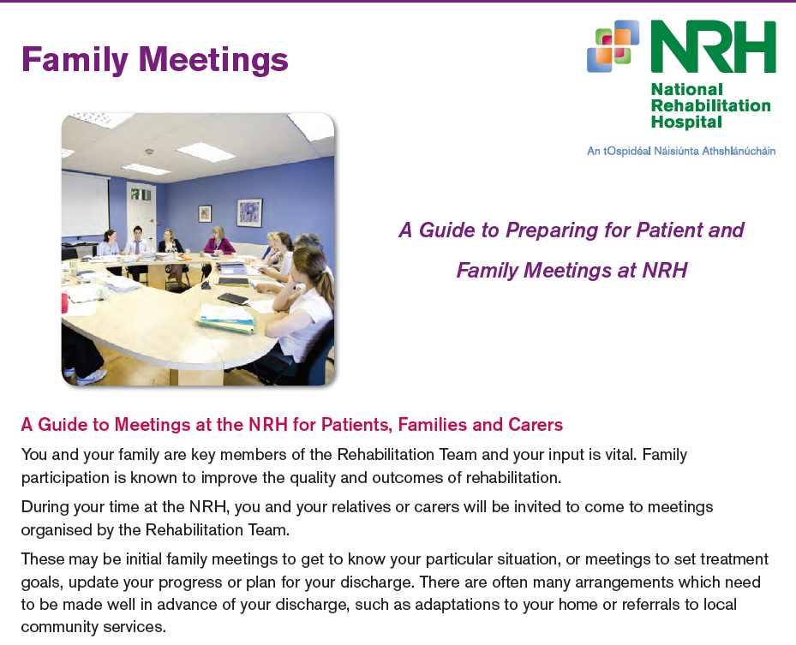
Family Meetings at NRH
150 staff potentially involved in family meetings which last approx 1-1.5 hours (60% of clinical staff at NRH)
Variety of rooms, styles, chairs etc
SW’s do pre-meeting preparation
Many families have to travel long distances and only be able to attend one family meeting
Motivations for the study:
There was a concern that we were not doing enough to include patients and families as fully as possible e.g. patients with cognitive communication impairments
Needed to review the timing, format, content and practical arrangements level of preparation, decision making/staff training
How do the other IDT members perceive the Social Work role/skills?
Increased research competency(CPD) and visibility of Social Work research – A need for ‘research by practitioners for practitioners’ (Epstein,2010)

Slide 3

Research questions
What is the purpose and role of Family Meetings for patients and families in a rehab hospital setting?
What are patients, family member and IDT member views and attitudes about Family Meetings and their participation within this forum?
Are patients and their family members satisfied with the level of participation and control afforded to them at Family Meetings?
Do IDT members feel sufficiently trained in the skills required to participate in Family Meetings?
Key objectives: service evaluation, quality assurance, changes and improvements to current practices will be made based on the findings of this study.
Notes:
Par is an ongoing organizational learning process, a research approach that emphasizes co-learning, participation and organizational transformation. (Greenwood et al, 1993).
The PAR process enables co-researchers to step back cognitively from familiar routines, forms of interaction, and power relationships in order to fundamentally question and rethink established interpretations of situations and strategies(Bergold and Thomas,2012)

Slide 4
Study Design
Included: inpatients who had been the subject of a Family Meeting
Excluded: Pt’s with Disorders of Consciousness, pt’s who were assessed as unable to participate in their Family Meeting in any meaningful way due to a severe cognitive impairment and pt’s who were children aged under 16 were excluded.
The social worker who was involved in each FM acted as a gatekeeper and invited the Pt and at least one or more family members to participate in the survey.
A member of the social work team who was not clinically involved with the Pt and family administered the questionnaire
SLT colleagues assisted if patients had particular communication challenges
All Social Workers involved in study at some level
Unfunded – extra to SW usual role
The survey included a mix of closed, open and multiple choice questions in order to gain the maximum amount of information from survey participants.
Access to other team members in relation to patients with communication/cognitive difficulties
Action Research
Mixed methods study design. Survey questionnaire administered via ‘Survey monkey’ completed either alongside Research Social Worker (Patient questionnaire),via email or through completion of a hard printed copy of the survey(Family members and Staff Survey).
Observation
Reflection/Analysis
Implement Change

Slide 5

Work Packages
Work package 1(Dec 2016-April 2017): survey of all IDT teams in the NRH (N=85 Approx 50% response rate).
Work package 2(April 2017-December 2017): survey administered to patients by personal interview by research social worker. Patients under the care of Brain Injury, Spinal and POLAR teams who have attended a family meeting N=80).
Work Package 3(April 2017-December 2017): survey given/sent to a minimum of one family member of each patient who has attended a family meeting (N=64).
Family members rarely used the online method – questionnaires had to be inputted manually
Notes:
We initially aimed to do 100 patients by June 2017!!
We would like to study a representative sample of Family Meetings which take place in relation to the three clinical groups under investigation; Spinal, ABI and POLAR.
Patients and Family members involved in each meeting will be invited to participate in the survey.
IDT member’s opinions of Family Meetings in general will be sought and therefore they will be invited to complete one survey only.

Slide 6

Blocks and Enablers
(Staff Survey Results)
Poor pre-meeting preparation
Staff arriving late/key IDT members not present
Poor communication and use of technical jargon
Differences in opinion between IDT members re: discharge plan
Pt/Family receiving new information which they have not been prepared for.
Pt/Family feeling their questions haven’t been answered/not listened to
Significant pre-meeting preparation
Expectations(Pt and Family) managed
Team Consensus and plan agreed
Skilled Facilitation
No interruptions
Comfortable, informal meeting room
No new significant information being shared and clarity on supports which can be accessed
Training for Staff
Notes:
77% of respondents had not received any formal training in family meetings
We would like to study a representative sample of Family Meetings which take place in relation to the three clinical groups under investigation; Spinal, ABI and POLAR.
Patients and Family members involved in each meeting will be invited to participate in the survey.
IDT member’s opinions of Family Meetings in general will be sought and therefore they will be invited to complete one survey only.

Slide 7

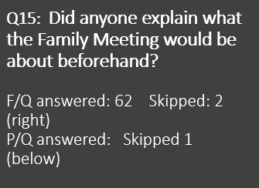
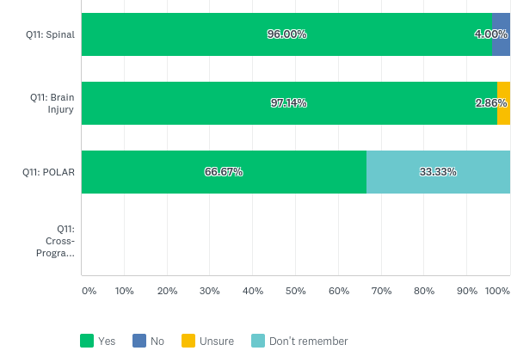
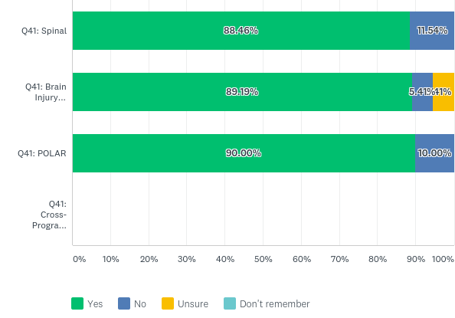
Q15: Did anyone explain what the Family Meeting would be about beforehand?
F/Q answered: 62 Skipped: 2 (right)
P/Q answered: Skipped 1
(below)
Family Member Response
Patient Response
Notes:
Very high rates for introductions also (95-100%)
Good rates for family prep – 91.67% / 82.86%/66.67%
Patient Prep (74) – 84.62%/ 71.05% / 90%

Slide 8

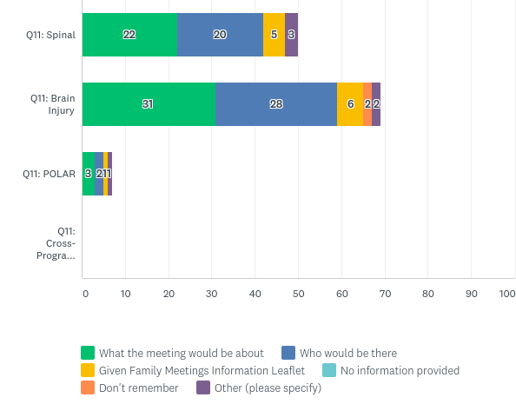
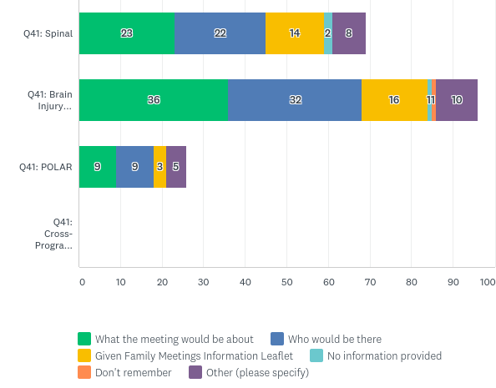
Q16: What information, if any were you given before the Family Meeting ?
F/Q Answered: 62 Skipped: 2
(right)
P/Q Answered: 73 Skipped:1
(below)
Family Member Response
Patient Response

Slide 9
What information would you have liked before the Family Meeting?
Family member surveys
Patient surveys
A specified person to tell you about the meeting – people kept saying “you know you have a meeting” but I didn’t know
Pre-meeting information and enough time to invite family
“I would have liked to have been prepared to answer… to know the questions that were coming up …..not to have 8-10 people “firing questions at you”
“It felt like getting my leaving cert results”
“Something to drink”
Not to be kept waiting half an hour
In the meeting?
Explanation of the condition
More information about NRH follow up and post discharge appointments
“What I am going to do for the rest of my life…”
More about carer support
Some people missing e.g. physio, consultant
What to expect
Who to contact later after some of the things said had been processed
A short agenda to outline the steps of the meeting might be helpful
We were reasonably prepared for the meeting but not for the formal “case conference” set up – for example the power point with all the patient’s information
To expect the delay
In the meeting?
A more conversational style

Slide 10

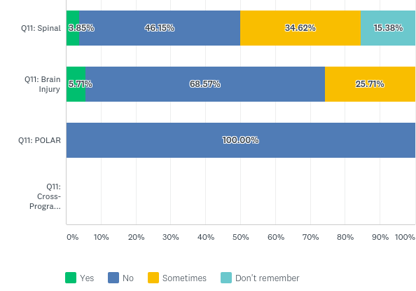
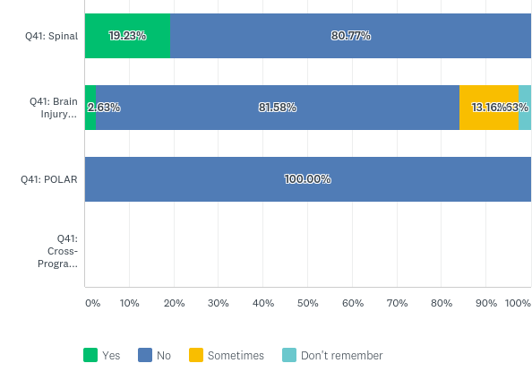
Q23: Was there anything talked about which you didn't understand during the Family Meeting?
F/Q Answered: 63 Skipped: 1 (right)
P/Q Answered: 74 Skipped: 0
(below)
Family Member Response
Patient Response

Slide 11
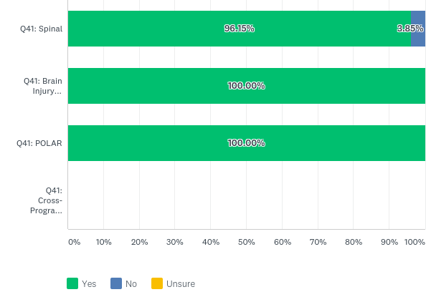
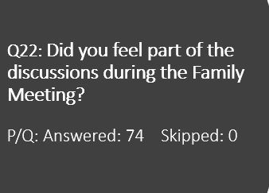
Q22: Did you feel part of the discussions during the Family Meeting?
P/Q: Answered: 74 Skipped: 0
Patient Response

Slide 12
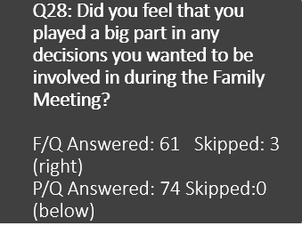
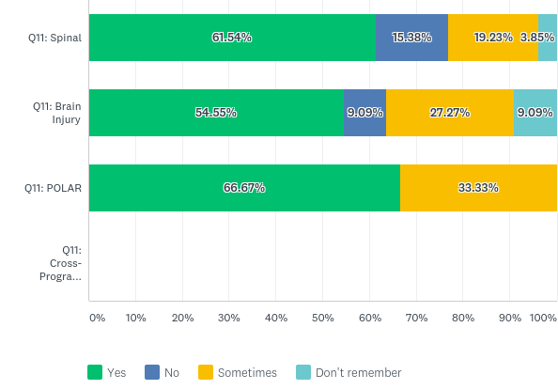
Q28: Did you feel that you played a big part in any decisions you wanted to be involved in during the Family Meeting?
F/Q Answered: 61 Skipped: 3
(right)
P/Q Answered: 74 Skipped:0
(below)
Family Member Response
Patient Response

Slide 13
Were there things you didn’t understand?
Patients’ Quotes
“…..a lot of medical talk which I had to get broken down in plain English”
“the info was explained during the meeting after I asked…”
“….explaining fancy words at times…. I had to ask them what they were saying…they explained it enough”
“….I understood everything or explanations were given…..but that was scary…that I won’t be 100%...that it could take up to a year”
“…medical terms used…my wife is a nurse- we had to look up the term but she could explain it to me….I didn’t stop to ask as I knew that my wife would explain it to me after the meeting”
“not one thing….very good here…..they’ve no problem answering any question”
“I didn’t know why I was being referred to the Irish Wheelchair Association (re driving) if I’m not in a wheelchair…my family clarified it…”

Slide 14
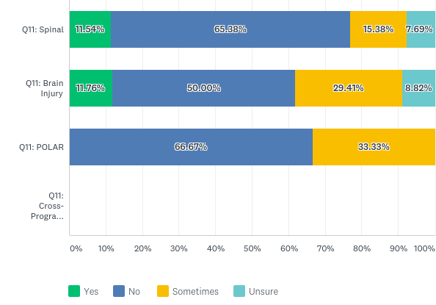
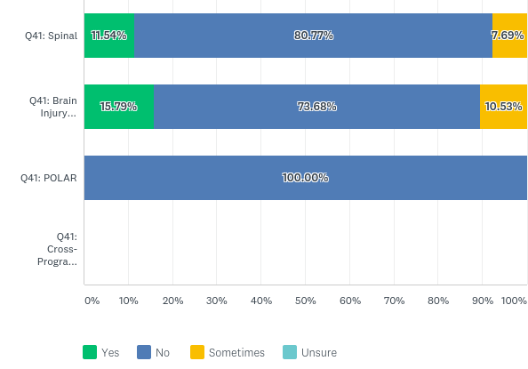
Q29: Did you find your Family Meeting upsetting or distressing at any stage?
F/Q Answered: 62 Skipped: 2
(right)
P/Q Answered: 74 Skipped: 0
(below)
Family Member Response
Patient Response

Slide 15
If you were upset – what caused it?
(Patients)
“Felt irritated, spoken at, didn’t feel like an equal partner….”
“Lack of eye contact with everyone in the (long) room”
“The fact they were stressing out my limitations with my wife beside me….plans that I have in my head were shot down. I’ve been making small improvements and my wife is happy with them”
“Felt I was on the defence…had to fight my own corner explain why decisions affected me”
“having my family to be told the facts of what I had been through”
“Scary to hear that I wouldn’t be 100% ….that it could take a year”
“If goals were not going to be achieved”
“It was the worse experience….very negative and stressful….
going over information I already know – it just brought it back”
“I am afraid that they might want to tell my family something but not me – they might think it would be too scary for me”

Slide 16
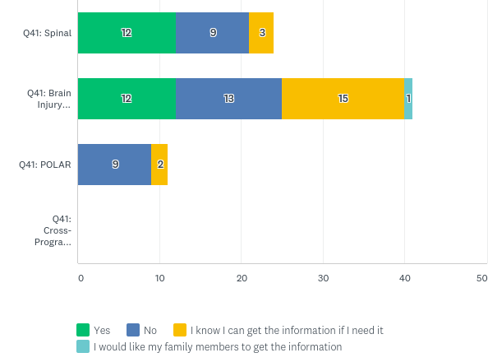
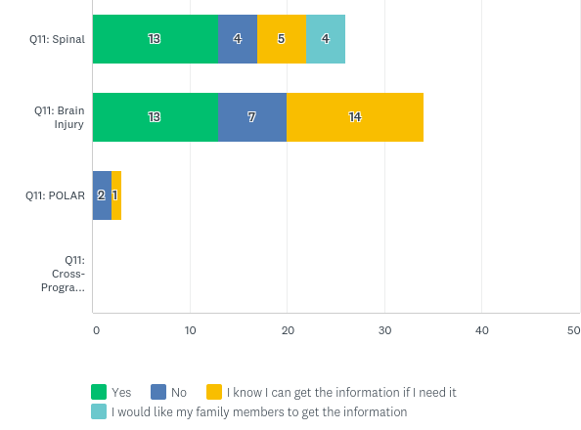
Q38: Would you like to have been given your own written copy of what was discussed or decided during the Family Meeting?
Would you have liked a written record of the meeting?
Family Member Response
Patient Response
F/Q Answered: 60 Skipped: 4

Slide 17
Patient Suggestions for Improvements
Clarity re expectations/a template of suggested questions or pointers – “what do my family need to know that I can’t tell them”
Meeting was too early for people travelling from the West of Ireland
A second meeting might be helpful
Be clear who the chair is
Make them more friendly/less formal/more relaxed “tell people that they are not in trouble….remind people to breathe”
More privacy – “might have things I don’t want shared with my wife”
Would have liked (different staff) present/the whole team – one person wanted less people
A cup of tea would have been nice
The team should give you hope and optimism
Bring everyone into the room at the same time
Don’t have people waiting outside – it’s intimidating
Help prepare patients e.g. to have a list of what they wish to discuss ready – perhaps a pre-meeting
“Stay short. Get all the key points in. Don’t be too long so you don’t fall asleep during it”
More post exit information and advice
A written copy of what was discussed
Suggestions about the room/seating/the long table
Ask the patient how they are doing
Tell the patient which staff will be present – “it’s only fair”

Slide 18
Family Member Suggestions
More free flow conversation/less formal environment
Input from the patient at the beginning – how they feel they are progressing
Patients need to feel heard – ask them how they are getting on, what is frustrating them, what is going well
Agenda/minutes/outcomes of the meeting
Solution focused rather than looking at barriers
Better seating/room arrangements (esp. long table)
Patient coming into the room last means it’s intimidating for them
More time for family members (patient joined later)
More focus on recommendations/strategies on discharge
A questionnaire about topics that are relevant that we might not have focused on
Families writing things down in advance
More options on times/dates
More notice
To have relevant people present
More information on the condition/what to expect and what to look
“Remind staff that though they may be well used to these meetings, it is nerve wrecking for patients and families”

Slide 19
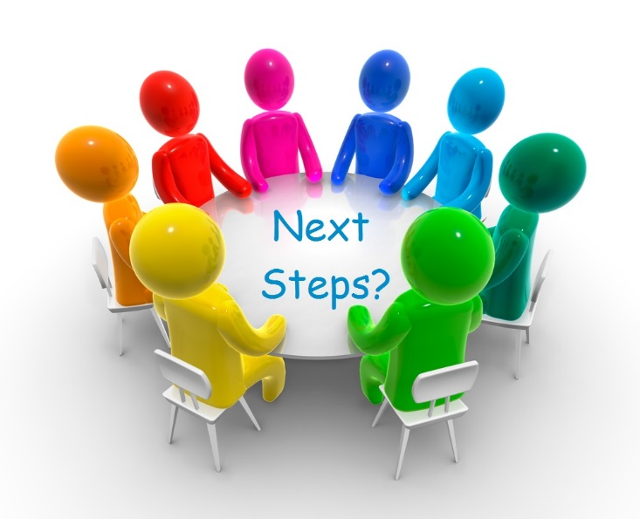
Where to next?
Improvement and changes
Patient and family involvement in this process
Templates and Training for staff
Review and re-audit
Capturing people who have more challenging communication difficulties

Slide 20


Thanks to…
NRH Staff, Patients and Family Members who participated in the study
Practitioner Researchers and Social Work Department NRH
Aidan Byrne, NRH Volunteer who assisted in data extraction
Dr Paul Carroll, Consultant in Rehabilitation Medicine, NRH

