Slide 1
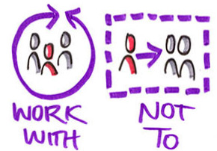

Service User Involvement/
Coproduction
in
Social Work Practice Development and Education:
A Narrative Review
Patricia Burns, Learning and Development Co-Ordinator

Slide 2
What?
Term Service User is not ideal?
Great variation in how both service user/carer involvement and co-production are understood (Evolving Concept)
Concepts are inter-related in that co-production cannot happen without the involvement of service users, but that co-production goes well beyond the idea of service user involvement
Notes:
Great variation in how both service user/carer involvement and co-production are understood.
Arnstein’s ladder of participation developed in 1970’s is still commonly used to understand involvement
For the purposes of this study it is accepted that the concepts are inter-related in that co-production cannot happen without the involvement of service users, but that co-production goes well beyond the idea of service user involvement

Slide 3
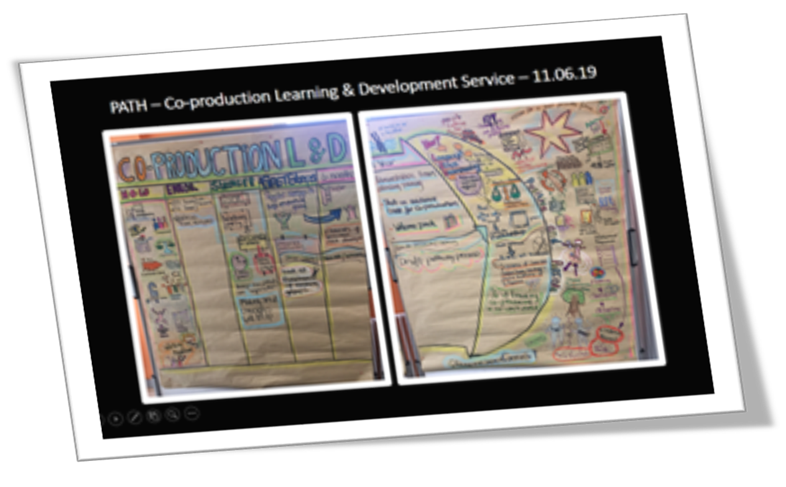

Slide 4

Why?
Drive for user involvement within healthcare has its origins in Primary health care, published by the World Health Organization (WHO) in 1978
Legal Requirement NI – (DHSSPS, 2009)
Embedded in key public policy across NI and UK for past 20 years (Health and Wellbeing 2026, Delivering Together – 10 year plan for Health and Social Care transformation, Social Work Strategy 2012)
Social Care is in Crisis - System wide change is driven by a need to do things differently in the delivery of adult social care – Power to the People (Kelly, & Kennedy, 2017)
Some practice guidance emerging/dearth of empirical research evidence
Notes:
The drive towards increased user and carer involvement in both health and social service provision has become well embedded in legislation and policy both in Northern Ireland and the rest of the UK over the past 20 years (DH, 1997).
It is acknowledged that these priorities cannot be delivered without the involvement of service users/carers,
The Department of Health (DoH) recently set out 16 proposals that aim to bring about radical change to Adult Social Care by putting “citizens at the heart” of decision-making, design and delivery of services. In a first step toward implementation and an attempt to demonstrate a serious commitment to putting words into action, the Department intends to liaise with service users/carers about how best to ensure all voices are heard in developing an effective way forward through co-production (Kelly, & Kennedy, 2017).

Slide 5

How?
3 databases searched: PsycINFO, Social Care On-Line and Social Services Abstracts
Inclusion criteria: Peer Reviewed, Empirical Research related to social work/social work education/service user involvement/participation/engagement/co-production
Exclusion criteria: Medical/healthcare, neighbourhood, community
11 Articles retrieved - 8 Qualitative Studies – Case Study/Focus Groups/Semi-Structured Interviews/Written Narrative & 3 Mixed Method – Survey/Web and Paper Based
Main Themes identified:
Service User/Carer and Practitioner/Student Perspectives
Challenges and Barriers/Models of Good Practice/Learning for Others/Outcomes

Slide 6
Findings
Majority of research retrieved related to involvement in social work education settings
Fairly mainstream approach in Universities
Widely considered as valuable
Students – better insight into service user and carer issues, increase in knowledge and skills and reflection around their core values
Service users/Carers - skills development, growth in confidence, social opportunities - Feeling valued, making a meaningful and purposeful contribution
People valued being paid
Focus on student learning outcomes, less on how this learning is translated to subsequent social work practice
Limited evidence on the inherent challenges for all those involved
Some concern about ‘tokenism’
Less research outside of formal educational setting

Slide 7

Conclusions/Recommendations
Dearth of Research Outside of University Settings
We have to consider challenges and barriers in order to find creative ways to overcome them
More service user/carers involved in meaningful roles - co-production approach
Further shift needed from ‘how’ service users/carers are involved to what makes their involvement meaningful and effective
Need to focus on outcomes
More hard evidence on whether the involvement of services users/carers brings about transformative changes or positive outcomes to social work practice.
Useful frameworks and models to overcome challenges - practical application outside of university setting
Clarity about how organisations and social workers should support the involvement of service users in all aspects of social work practice.

Slide 8
Next Steps
Co-produced small Scale Qualitative Study – 12 participants
Face to face interviews
Service User/Carer Advisory Group – research design input – e.g. target population, interview questions, inclusivity and accessibility of research
Group meet regularly sharing ideas, assessing progress and reflecting on the research project.
One member of the group undertook additional training on thematic analysis, coding, use of specialist software to provide further support in terms of thematic analysis of interview transcripts – NVIVO
Presentation of final report September 2019

Slide 9
Thank You

Slide 10
References
DH (1997) The NHS: Modern, dependable, London: DH
Department of Health, Social Services and Public Safety: (2009) Personal and Public Involvement (PPI) under Circular HSC (SQSD) 29/07, London: DH.
DHSSPS (2012) Improving and Safeguarding Social Well-Being: A Strategy for Social Work in Northern Ireland 2012-2022. Available at https://niscc.info/storage/resources/2012april_dhssps_socialworkstrategy2012-2022_afmck1.pdf accessed Sept 2018
Department of Health (2016) Health and Wellbeing 2026: Delivering together. DoH: Belfast
Kelly, & Kennedy (2017) Power to the People: Proposals to Reboot Adult Care & Support in N.I. https://www.health-ni.gov.uk/articles/power-people accessed 9.6.19
WHO (World Health Organization) (1978) Primary health care, Geneva: WHO.

