Slide 1
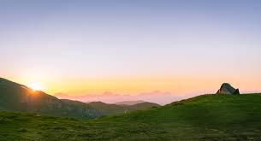
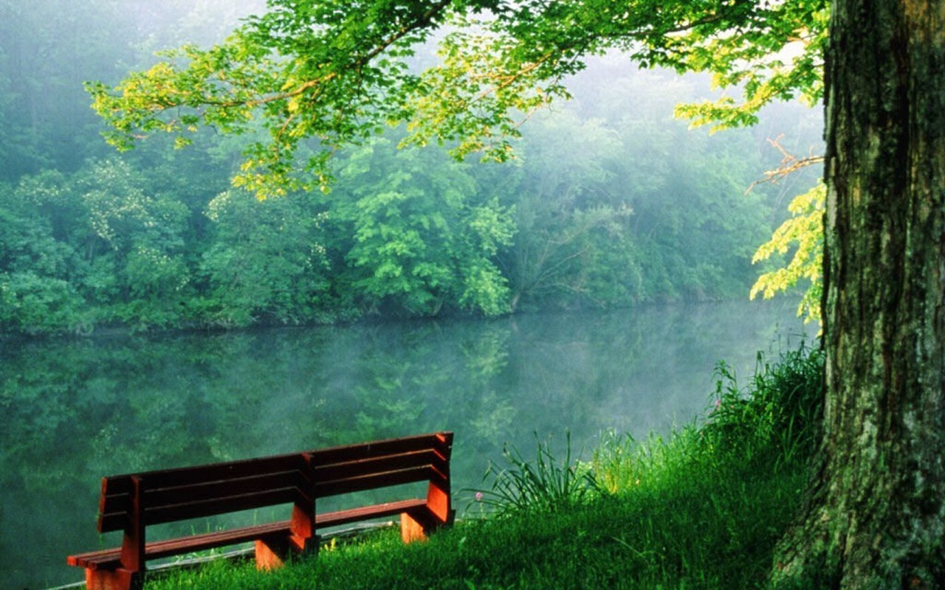
Does the natural non-human environment have a role to play in the way Social Work regards human development?
Laura Cullen
Supervisor: Professor Stan Houston

Slide 2
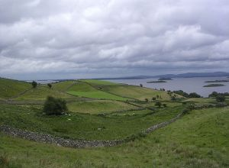
Background
Natural environment missing from theories of human development
The crisis of climate change
My own nascent intuition
IFSW Global Agenda for Social Work

Slide 3
International Social Work Conference Dublin
The third pillar of the Global Agenda is Environmental sustainability
Mel Gray said “there is still a huge amount of work to do to convince social work that the environment is social work’s business”

Slide 4
Aims and Objectives
To answer the research question
To review current studies on the influence of the natural environment on human development (mental health, identity formation and childhood development)
To challenge Social Work’s person-in-environment construct
Power and inequality – reflexivity

Slide 5
Research Questions
Should the natural non-human environment have a role to play in the way Social Work regards human development?
What is the impact (psychologically, spiritually, physically) of the natural environment on human persons?
What are some practical ways Social Work can incorporate an environmental sensitivity into its theory and practice?
How can this information inform theories of human development and how people are encountered and understood within Irish organisational Social Work settings, such as Tusla.

Slide 6
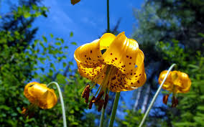
What does the literature say?
Human Development
Connection and meaning
Future education of social workers in universities/colleges.
Inequality

Slide 7
Methodology
Qualitative narrative literature review
The philosophical underpinnings = hermeneutic phenomenology, and of particular influence was the philosopher Martin Heidegger.

Slide 8
Summary of Findings
The natural environment has an impact on:
Childhood development
Mental health
Identity formation
Empathy levels

Slide 9

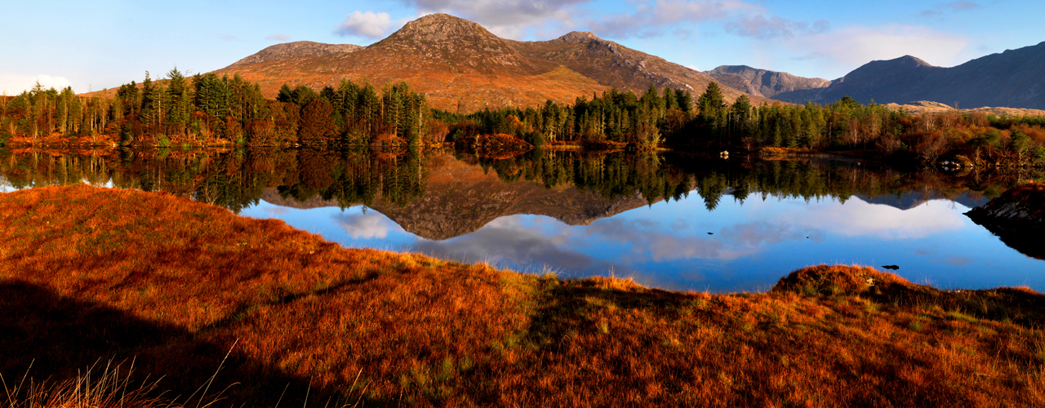
Access to nature is not free or available to all (the impacts of climate change will disproportionality effect poorer people).
Access to nature is not free or available to all (the impacts of climate change will disproportionality effect poorer people).

Slide 10
Implications for Social Work
Our natural surroundings have an effect on us, and holistic Social Work practice should acknowledge this.
eco-assessments (a person’s coping mechanisms); TOPS; education; community based work; having a voice in the public sphere
Social Workers are ideally suited to embrace the challenge that climate change puts forth.

