Slide 1




“Exploring Connections: Examining homelessness and substance use in Northern Ireland, through an ongoing mixed-methods study”
Amanda Shields – PhD in Social Work
School of Social Sciences, Education and Social Work, QUB
ashields10@qub.ac.uk @amandashields86
#AISWR

Slide 2


Hello!
About me…
About this presentation…

Slide 3

When you think of homelessness, what images come to mind?

Slide 4
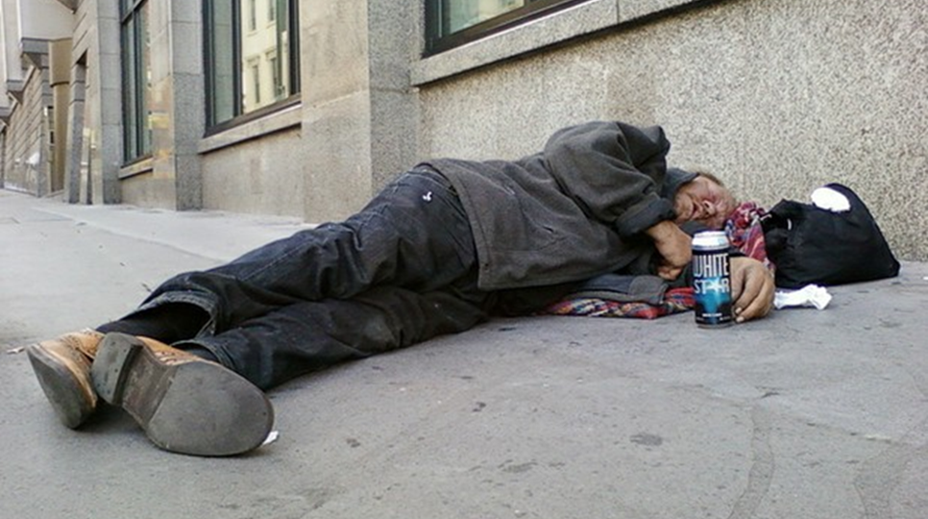
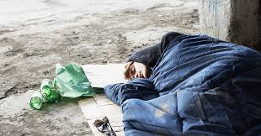
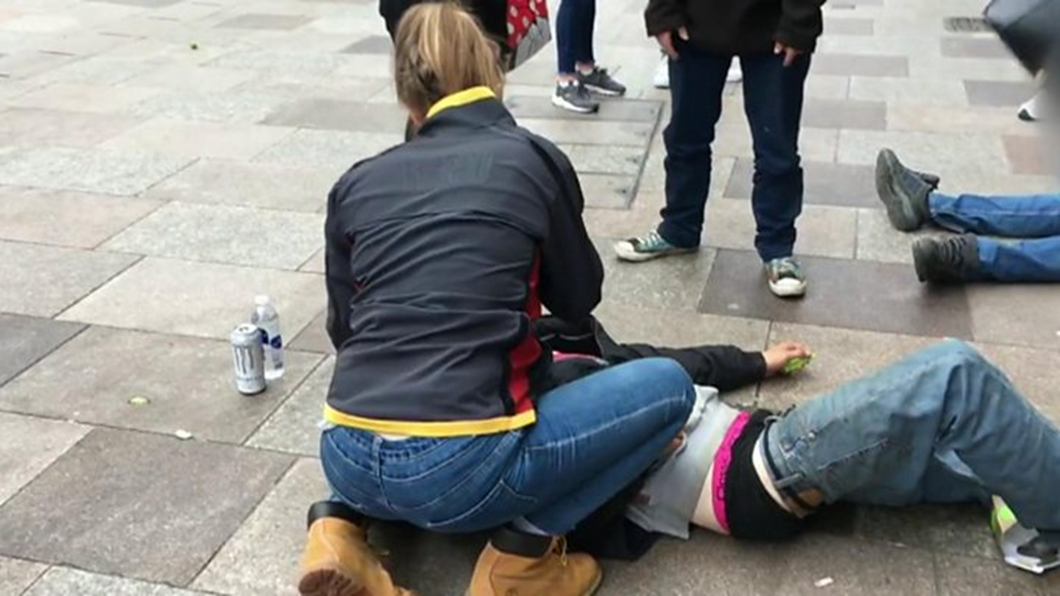
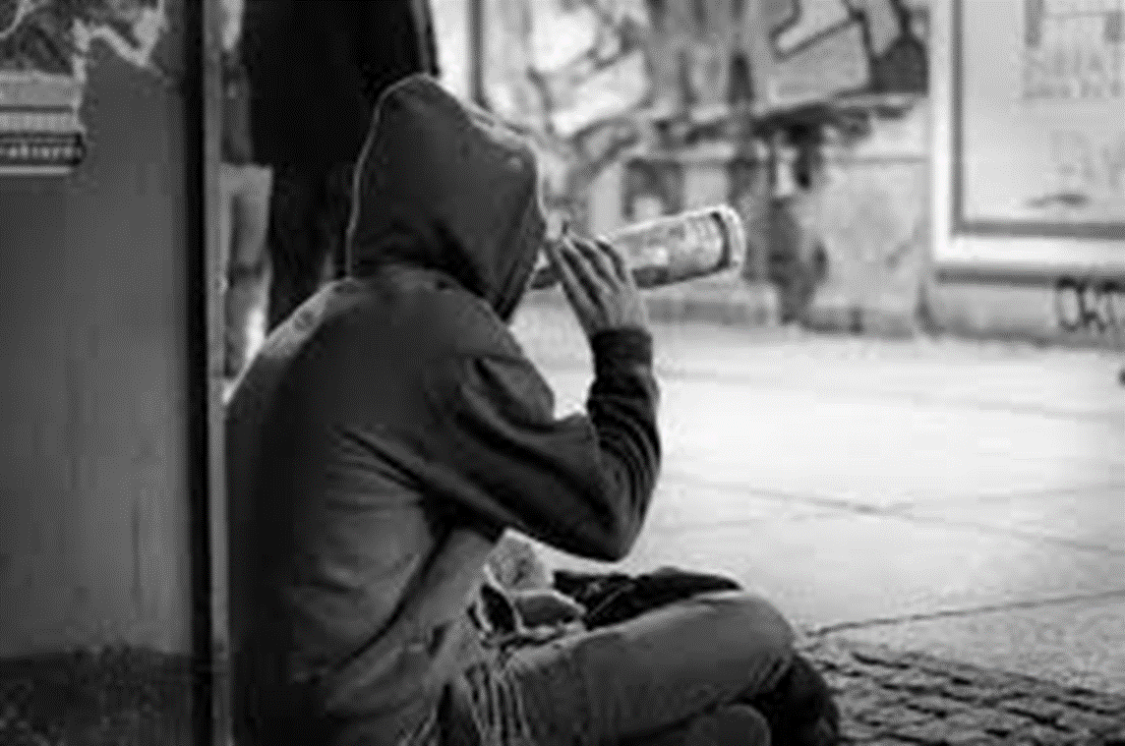
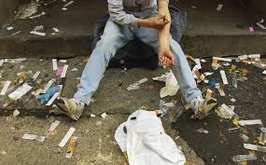
When you thought of homelessness, did you also think of substance misuse?

Slide 5

What does the evidence tell us about homelessness and substance use in NI?
(Spoiler… not a lot!!)
People who are homeless are 20 times more likely to die from drug misuse (DoH, 2019).
Homelessness is an escalating problem within NI with a 32% increase noted in the last 5 years (Murphy, 2017; NIHE, 2017).
“The research indicates that substance use is a factor in becoming homeless, and remaining homeless”
(Murphy, 2016)
Top reasons for homeless
Sharing breakdown
Loss of accommodation
(NIHE, 2019)

Slide 6
“There is no breakdown that would suggest the prevalence of substance use being a contributory factor in why a person presents as homeless. Furthermore, there is a significant gap in homeless research with little evidence outlining the scale of substance use issues within the current homeless population (Donnelly, 2017).
It has been argued that NI needs more specific data, therefore it would be understandable to contend that we cannot accurately discuss the link between homelessness and substance use or attempt to address this on a policy and practice level, in the absence of robust research
(Donnelly, 2017).

Slide 7



So… why is it important that we learn more about the link between these two issues?

Slide 8

What did I want to find out and how?
Realism vs Relativism
Desire for ‘one single truth’ through empirical data for stakeholders, policy makers etc.
Recognition that there may be more than one truth through individual, subjective lived experiences.
+
Due to the array of aims, it was necessary to conduct this study by adopting a mixed-methods approach (Creswell, 2003) within a pragmatic paradigm (Tashakkori and Teddlie, 1998) through three concurrent phases (qual-quant-qual).

Slide 9
Phase One – Focus Groups
Who?
How many?
1 group in Belfast with 6 practitioners and
Why?
To ascertain the experiences and perspectives of practitioners working frontline in homeless services so that we can understand more about these issues
1 group in Western Trust with 5 practitioners
Practitioners working in homeless services in NI, made up of social workers and social care managers – purposive sample
Some Preliminary Findings… what are practitioners saying?
Demographic profile of homelessness in NI has changed over past 10 years – previously was mainly older males with alcohol dependency, now more young people with drug misuse issues.
Trauma and adverse childhood experiences are common triggers for homelessness with their service users.
Heroin is a significant issue in Belfast Trust area, not so much in Western area where prescription drug misuse is very prevalent.
Calls for a ‘bespoke model’ in hostel provision. There is a need for better transition from hostel to tenancy, to prevent repeat homelessness.

Slide 10




Phase Two – Surveys
Key Challenges!
Who?
People who are currently homeless and living in hostels or using homeless drop-in centres in NI.
How many?
This was a saturation survey so the entire population of participating homeless hostels and drop-in centres in NI were invited to take part – 50 projects participated and 503/1100 surveys completed (46% returned) to date.
Why?
To understand the current demographic profile of people living in homeless hostels.
To identify themes and trends, that enables us to make generalisations about the link between homelessness and substance use in NI.

Slide 11
Phase Three – Semi-structured Interviews
Who?
People who are currently homeless and engaged in homeless services in NI. Purposive and snowball sample.
How many?
Why?
30 individual interviews with people from a range of homeless projects across NI. 18 males and 12 females.
To hear and appreciate the lived experiences and perspectives of people who are homeless.
To give people who are homeless a voice and respect the ethos “nothing about us, without us!”
“People think that because you are homeless and have a problem with alcohol or drugs, that it’s your own fault and don’t deserve help. They don’t understand why someone might use these substances. For me personally, I drank too much and took some drugs to escape from the hell that was in my mind. Yes, this caused me to lose my flat and become homeless, but I think if people were more aware that I was having problems then maybe they could’ve helped me from becoming homeless.”
“I didn’t start using drugs until I was homeless and living in a hostel. I think I was vulnerable and lonely and wanted to fit in. At the time it made me feel better about being homeless and I could switch off from my problems. Now I have an addiction to heroin and it has made my problems worse. Drugs are keeping me homeless.”

Slide 12

Concluding thoughts…
Being a social worker has made this research possible. Social work research is vital!
Need to think about vicarious trauma – as a researcher we still need to utilise supervision and link in with key supports.

Slide 13
References
Creswell, J.W. (2007) Qualitative Inquiry and Research Design: Choosing Among Five Approaches (2nd edition), London: Sage Publications Ltd.
Department of Health [DoH] (2019) New NI nursing campaign launched to tackle key health issue, available at https://www.health-ni.gov.uk/news/new-ni-nursing-campaign-launched-tackle-key-health-issues-nursingnowni
Donnelly, K. (2017) NIAO: Homelessness in Northern Ireland, available at https://www.niauditoffice.gov.uk/sites/niao/files/media-files/Homelessness%20in%20Northern%20Ireland%20Full%20Report_0.pdf
Murphy, E. (2016) What do we know about homelessness in NI? An overview of some of the evidence base. available at http://www.niassembly.gov.uk/globalassets/documents/raise/publications/2016-2021/2016/communities/4216.pdf
Murphy, E (2017) The many faces of homelessness in Northern Ireland, available at https://www.assemblyresearchmatters.org/2017/03/13/many-faces-homelessness-northern-ireland/
Northern Ireland Housing Executive [NIHE] (2017) Homelessness Strategy for Northern Ireland 2017-2022, available at https://www.nihe.gov.uk/index/corporate/strategies/homelessness_strategy.htm
Simon Community (2016) Homelessness in Northern Ireland, available at https://www.simoncommunity.org/assets/pdfs/Homelessness-in-Northern-Ireland-Publication-01.01.16.pdf
Tashakkori, A. and Teddlie, C. (1998) Mixed Methodology: Combining Qualitative and Quantitative Approaches, London: Sage Publications Ltd.

