Slide 1
All-Ireland Social Work Research Conference
14th June 2019
Mary Neligan

Slide 2
Implementing Article 42A of the Constitution of Ireland on the Right of the Child to be involved in the adoption decision-making process?
A Literature Review

Slide 3
UNCRC, 1989 - Article 12
Article 42A, 2015
Adoption (Amendment) Act, 2017
Notes:
History UNCRC-Article 12

Slide 4
Article 42A
‘Concerning the adoption, guardianship or custody of, or access to, any child, the best interests of the child shall be the paramount consideration.
….in respect of any child who is capable of forming his or her own views, the views of the child shall be ascertained and given due weight having regard to the age and maturity of the child.’
(Bunreacht na hEireann, 2015, p:166).

Slide 5
Why social workers should include children in decision-making
Legal
Conceptual
Practical
(McCafferty, 2017)

Slide 6
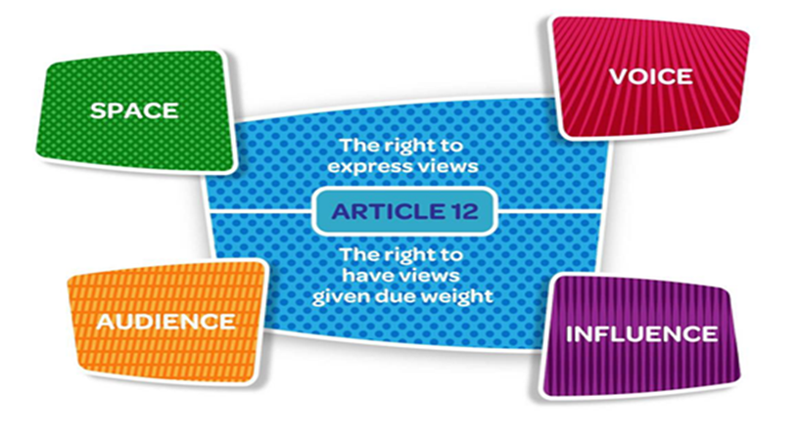
Lundy’s Model (2007)

Slide 7
Listen to Our Voices! Hearing Children and Young People Living in the Care of the State (McEvoy & Smith, 2011)
Buckley et al., 2011.
Daly, 2014.
Glynn and Mayock, 2018.
Holt, 2018.

Slide 8
Obstacles to engaging children in decision-making
A lack of communication skills
A focus on protection
The extent to which professionals believe in the principle of participation and children’s involvement in decision- making. (Vis et al., 2012)

Slide 9
Thank You

