Slide 1

Promoting Research Collaboration with
Service Users
Niamh Flanagan

Slide 2
One key quality distinguishes
service user knowledge
from all others
it alone is based on direct experience
of policy and service provision
from the
receiving end.
The shorter the distance between experience and its interpretation the more accurate the research is likely to be.
(Beresford, 2000)

Slide 3

Service Users
term ‘service user’
Meaningful & central role in research

Slide 4






Service Users in Social Work Research
1900s
1950s
1970s

Slide 5





Service Users in Social Work Research
1970s
1980s
2000s

Slide 6


Service Users in Social Work Research
2019

Slide 7
Why the delay?
“although service user involvement
in research is desirable,
it remains unclear
what this means in practice”
(Loughran & McCann, 2013)

Slide 8
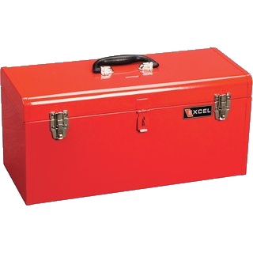
The Social Work
Research Toolbox

Slide 9

The Social Work
Research Toolbox
What tools do social workers have to engage in service user research?

Slide 10
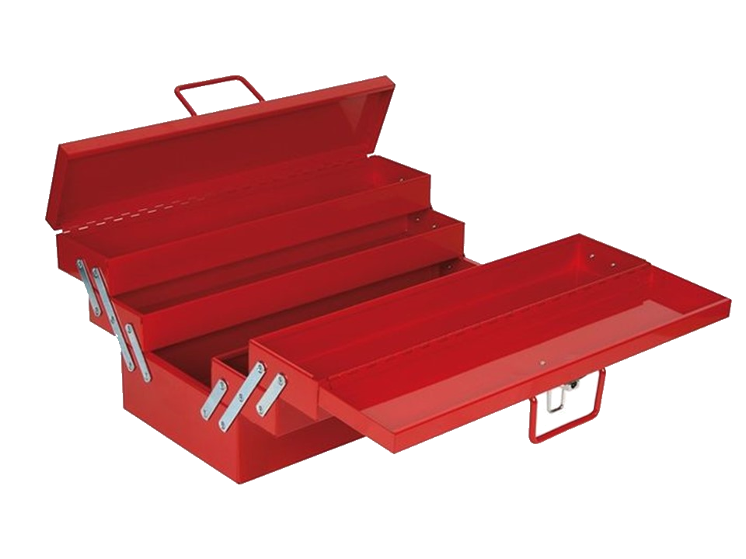
The Social Work
Research Toolbox
Consider the different layers in the toolbox

Slide 11
The Social Work
Research Toolbox
Quantitative or Qualitative

Slide 12
The Social Work
Research Toolbox
Quantitative or Qualitative
Research Method

Slide 13
The Social Work
Research Toolbox
Quantitative or Qualitative
Research Method
Research Design

Slide 14
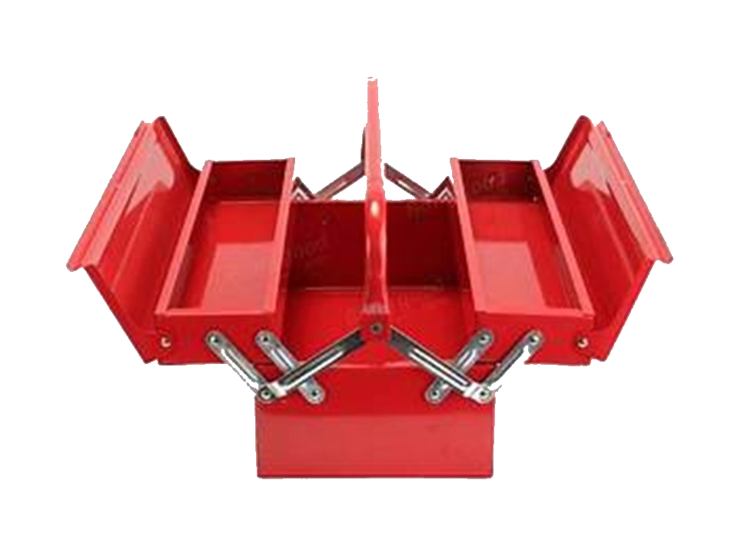
The Social Work
Research Toolbox
Research Type

Slide 15

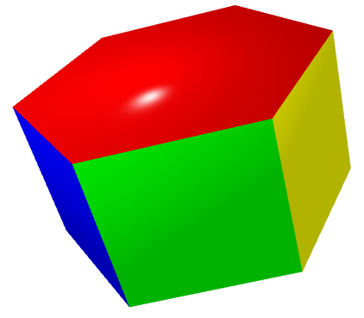



The Change Continuum
Knowledge – Improvement – Solution – Change – Empowerment - Participation
Contribute to knowledge / understanding
More action than knowledge/
Mid-term change
Give voice to the marginalised
Empower people to make change
Solution to a specific problem
Emancipatory
Research
Participatory
Research
Applied Research
Empowerment
Research
Basic
Research
Action
Evaluation
Research
Research
Evaluate a Process
Partnership, Collaboration, User-Control
Research Type
Notes:
Community Participative methodology to support service user engagement as participants in research while working towards advancing collaboration strategies to enhance service users’ role as researcherers (L&Mc)
Participatory research is defined not by particular theories or methods but by who defines the research problem, who generates the analysis, represents, owns and acts on the information which is sought (Littlechild, 2015)

Slide 16
The Social Work
Research Toolbox
‘Research Type’ is the foundation
Choose appropriate design, method and data type
Quantitative or Qualitative
Research Method
Research Design
Research Type

Slide 17
Participatory Research
Research which is done with or by service users or community
- rather than on, about or for them as research subjects -
through active involvement in the research process
Handing the ‘power’ of the researcher to service users / community
Notes:
cited in Littlechild et al
Participatory Action Research PARS the researcher is seen as a facilitator who can empower people to develop their own knowledge a tke action (Cosser)

Slide 18

Why do Service-user Research?
Equality of relations in research production
Shared ownership
Empowerment of service users
Improvement of their lives through process & purpose
Being part of a social and political change
Based on social models of understanding & interpretation
Quality of research
Notes:
(Turner & Beresford 2005) in McLaughlin

Slide 19

Hierarchy of
Service-user Research
Control
Collaboration
Contribution
Consultation
Tokenism
Non-Researcher
Adapted from Arnstein, 1971; Hanley et al, 2003; Sweeney & Morgan, 2009; McLaughlin, 2010
Notes:
A continuum of involvement in research (different levels of training Gutman and Ramon)
Consultation, Collaboration & Control (Hanley, cited in L&Mc)
Partnership is a formal relationship with rights and responsibilities, whereas collaboration refers more to people more informally agreeing to work jointly (Fleming et al)
Contribution – researchers do more than asking service user’s opinions, actively involving them throughout the research process, but without sharing decision making powers (Sweeney & Morgan in Cossar).
Frustrated participation – exclusion by actions such as inaccessibility, cost, making it difficult for people to participate
Consultation – ask for input, may influence you, won’t necessarily adopt it (Targeted or embedded consultation, Hughes and Duffy)
Contribution – degree of involvement advisory committee,
Collaboration – degree of involvement from advisory committee, establishing research questions, identifying research tools, analysing data, writing up the report or disseminating findings (maybe not involvement in every aspect). How much is enough is still open to debate.
Control – locus of control is with the service user; determining the research focus, the process, the interpretation of findings and conclusions drawn. How much is enough is still open to debate.

Slide 20
Who might be involved in Community-based Participatory Research?
Professionals working in the community
Collaborating Researchers
Co-Researchers
Community locals
Indirect Service users
Direct Service Users
Commissioned Researchers
Notes:
Affiliated Participation Researcher – Professionals working but not living in the community (L&Mc)
Immersed Participation Researchers – locals or service users within the community
Direct service users – using or have used the service
Indirect service users – those who have experience of a similar service elsewhere
Alternative researchers – service users but researching in different area of provision (McLaughlin)
CPR - While privileging the voice of the community, include expertise that can contribute to collective action (L&Mc)
Commitment to social justice, collective action and social change (L&Mc)
Community-based analysis of social problems and oriented toward community action. (L&Mc)

Slide 21
Involvement at each stage
Designing & Planning
Recruitment
Data collection
Data Analysis & Interpretation
Write-up
Questions
Dissemination
Ownership
Initiation
Broader involvement of service users the further up the hierarchy
Notes:
An academic approaches and invites others often after funding has been secured and much of the methodology set (Fleming)
User-led … come together to devise the project and apply for funding as a team
Communities themselves are a source of data but are also invaluable in term of data interpretation (L&Mc)
Service users’ contribution is valuable in itself and is not dependent on service users developing ‘research expertise’

Slide 22
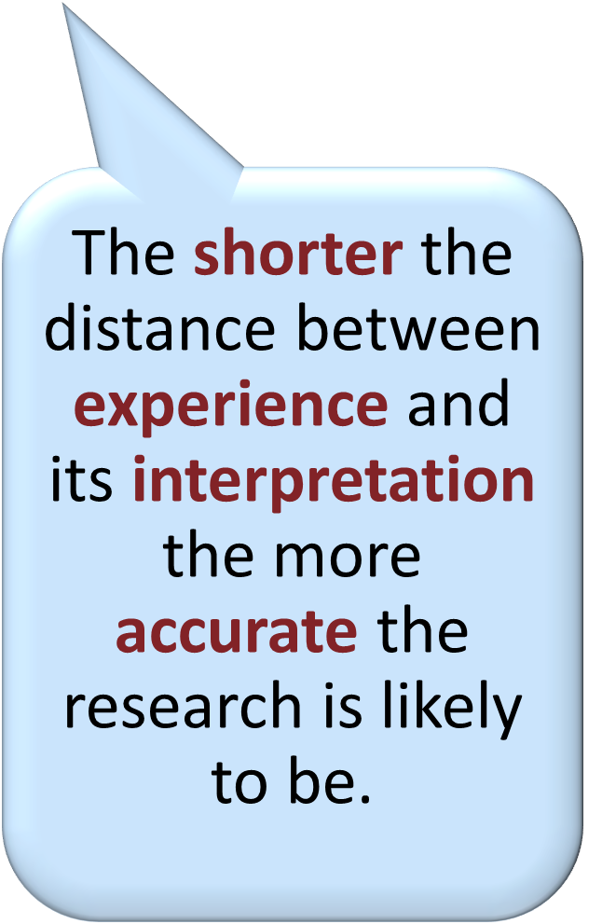
Potential Benefits for the Research
Enhanced Process
Improve Outputs
Methods appropriate
Recruitment optimised
Ethical practice more sensitive
Questions relevant
Respondents more at ease
Conceptualisation accurate
Richness & quality of data
Relevance, impacts & value
Acceptability
Dissemination accessible
Direct dissemination more powerful

Slide 23
Potential Benefits for Peer Researchers
Increased knowledge, awareness, confidence, self-esteem
Community
Active / purpose in their community
Improving community capacity
Reduced power differentials
Renumeration & employability
Empowerment
Meeting others in similar situations
Part of positive outcomes for their lives
Notes:
Increased knowledge, awareness and confidence (G&R & McLoughlin
Meeting others in similar situations
Empowerment (G&R)
Active in their community (G&R)
Improving community capacity for addressing needs (G&R)
Bringing about positive outcomes for their lives (G&R)
Reduced power differentials between partners (Fleming et al)
Powerful learning experience (Fleming et al),
Costs
Time consuming
Financial trade-off
Emotionally draining / demoralising
Expectations of change raised
Risk of tokenism / exploitation

Slide 24

What’s Involved in Setup?
Planning
Resources - money, time, input
Relationships & Roles
Communication channels
Needs - emotional, practical, research support
Willingness to learn & overcome challenges
Preparing
Training, support & facilitation
Getting Started
Breaking down the research into manageable tasks
Negotiate Roles and Responsibilities
Formal contract
Payment in line with employment law
Work inclusively & Give feedback
Notes:
(all L&MC unless spec)

Slide 25

Challenges
Power & control, interpersonal dynamics - collaboration requires teamwork
Differing opinions about
  aims & methods
  roles of stakeholders
Work can be unpredictable, liable to change, not the same as usual
Time consuming / Frustration about the speed of work & impact
Resource Intensive / constant support
Ethics / gatekeepers paternalistic view of vulnerabilities
Peerness – how close is close, or too close?

Slide 26

Weighing it Up
.
.
Do the practical realities of service-user research outweigh the moral arguments for participation?
Are even limited participatory initiatives generally preferable to an absence of involvement?
Limited systematic evaluation of process
Notes:
More research is needed to sharpen and broaden our understanding of the potential outcomes of such partnerships with service users (G&R)

Slide 27
References
Arnstein, S. (1971). A ladder of public participation in the US. Journal of The Royal Town Planning Institute, 176-182.
Beresford, P. (2002). User involvement in research and evaluation: liberation or regulation?. Social policy and society, 1(2), 95-105.
Cossar, J., & Neil, E. (2013). Service user involvement in social work research: learning from an adoption research project. British Journal of Social Work, 45(1), 225-240.
Fleming, J. et al. (2014). Working together–innovative collaboration in social care research. Qualitative Social Work, 13(5), 706-722.
Gutman, C., & Ramon, S. (2016). Lessons from a comparative study of user involvement. Social Work Education, 35(8), 878-891.
Hanley, B. et al, (2004). Involving the public in NHS public health, and social care research: briefing notes for researchers. Involve.
Littlechild, R. et al. (2015). Co-research with older people: perspectives on impact. Qualitative Social Work, 14(1), 18-35.
Loughran, H., & McCann, M. E. (2013). Employing community participative research methods to advance service user collaboration in social work research. The British Journal of Social Work, 45(2), 705-723.
McLaughlin, H. (2009). Keeping service user involvement in research honest. British Journal of Social Work, 40(5), 1591-1608.
Sweeney, A., & Morgan, L. (2009). Levels and stages. Handbook of service user involvement in mental health research, 6.

