Slide 1
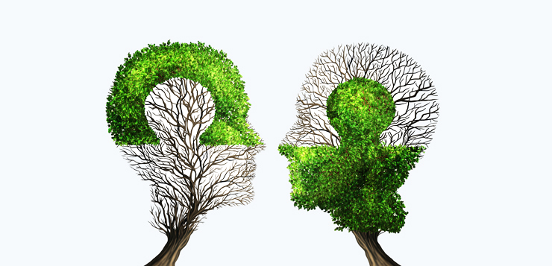
Relationships and
The Art of Recovery
Gary Broderick
IASW Annual Conference
10th May 2019

Slide 2
I am who I am because of the people,
situations, and conditions that have
intersected to create this thing I call “my
life.”
My “self,” as I understand and also narrate
it, is an intermixture of the relationships
through which I have arisen. There was no
me before these experiences; I am created
by and through these experiences.
Buddha

Slide 3
Relationality:
Jean Baker Miller: The relational model, 1986
Mutual: (of a feeling or action) experienced or done by each of two or more parties towards the other or others.
Empathic: of, relating to, or characterized by empathy, the psychological identification with the feelings, thoughts, or attitudes of others
Creative: having the quality or power of creating.
Energy Releasing: to give energy to; rouse into activity
Empowering: to give ability to; enable or permit

Slide 4
Let me tell you about…
Patrick
Colin
Jen
Jess
Not their age or their drug use or their crime…but Liverpool and journalism and Cork and Rap and hanging doors and drama and politics and mental health services and stockings and Edinburgh and family systems and comedy…

Slide 5
“Who is your client?”
Mearns and Thorne (2003, 14) recognise the individual’s capacity to fulfil their goals and make positive, behaviour changes:
“All clients have within themselves vast resources for development. They have the capacity to grow towards fulfilment of their unique identities...and attitudes or behaviours can be modified or transformed”.
This philosophical position points to the actualising tendency that all humans possess. (SAOR II, page 40-41)

Slide 6
Trauma
“Even though the trauma may have occurred long ago, patients treat themselves in ways that repeat it, ignoring their needs and perpetuating pain (albeit sometimes in the guise of trying to satisfy short-term impulses)” Najavits, 2002, Page 5)

Slide 7
People with addictions and trauma
“often need to learn to take care of themselves. For example, if you think about suicide a lot, you may not feel that it’s worthwhile to take good care of yourself and you may need to make a special effort to do so…excessive substance use is one of the most extreme forms of self-neglect because it directly harms your body…the goal is to work on improving your self-care through daily efforts”. (Najavits, 2002, Page 180)

Slide 8
Collaboration/Partnership
Are your clients ‘problems to be solved
KPIs
Hurdles or tests
A resource for you in your work with them?

Slide 9
Continuum of Intervention
Directive
Guiding
Following

Slide 10

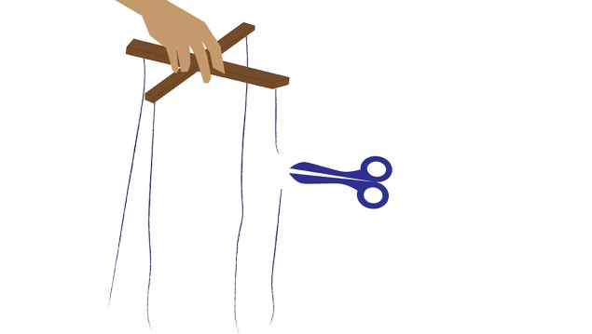
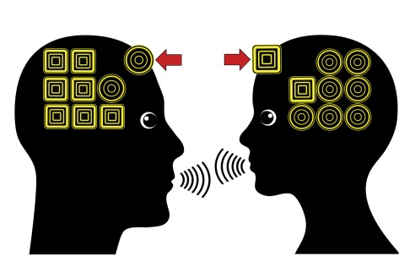
Acceptance
Absolute Worth
Autonomy
Affirmation
Accurate Empathy

Slide 11
When did you ask for permission to offer help?

Slide 12
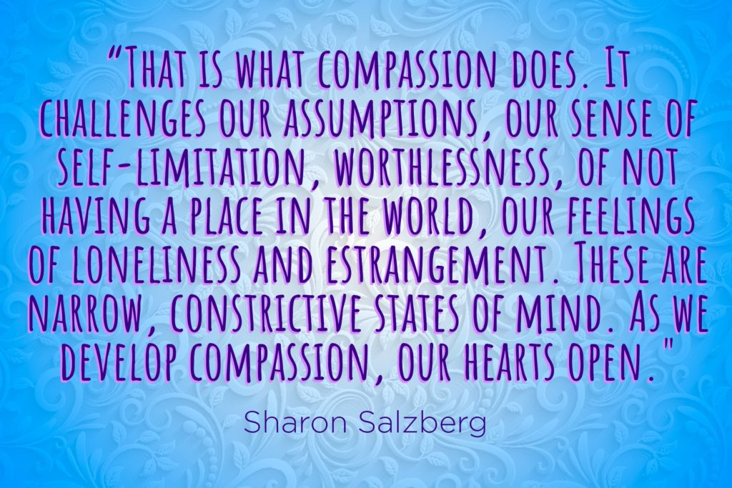
Compassion

Slide 13
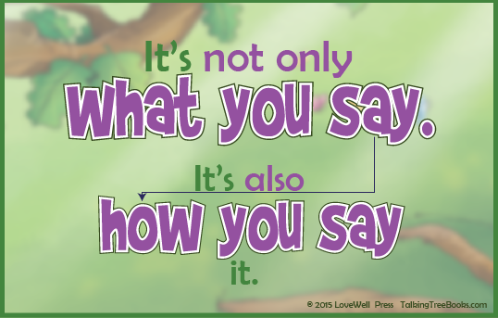
Kindness

Slide 14
The opposite of addiction is not sobriety. It is human connection.
Johann Hari, (2014)

